Slide 1
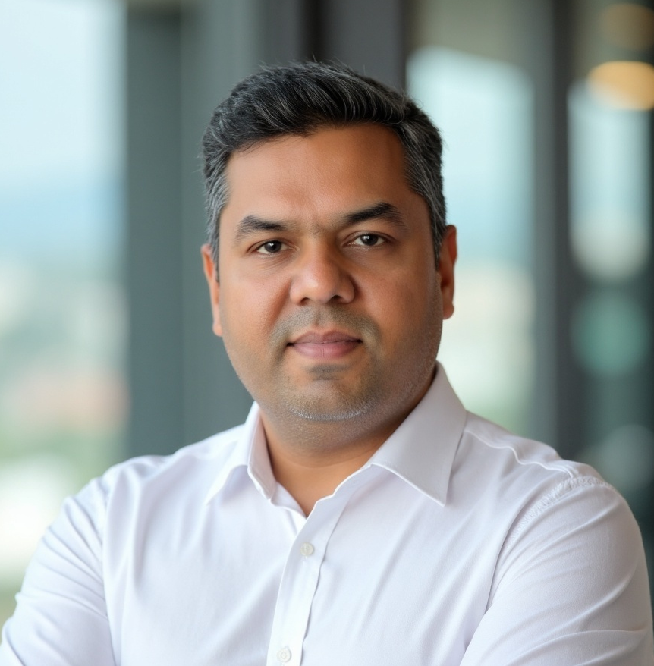
Welcome
Samir Karpe
Country Manager,
DV India

